Slide 1


ECEN 404
Creating STEM Contents: Solar Power with a Tracking System
Status Update #1
Leo Predanic
George Thuita
Brandon Cenci
Sponsor: Dr. Won Jang
TA: Souryendu Das

Slide 2

Executive Summary
Problem statement:
To create the future of tomorrow, we must invest today - by getting students interested in STEM early
Our Solution:
Excite K-12 students by creating a portable solar system for demonstration purposes
Contain digestible figures & animations to describe/track system

Slide 3
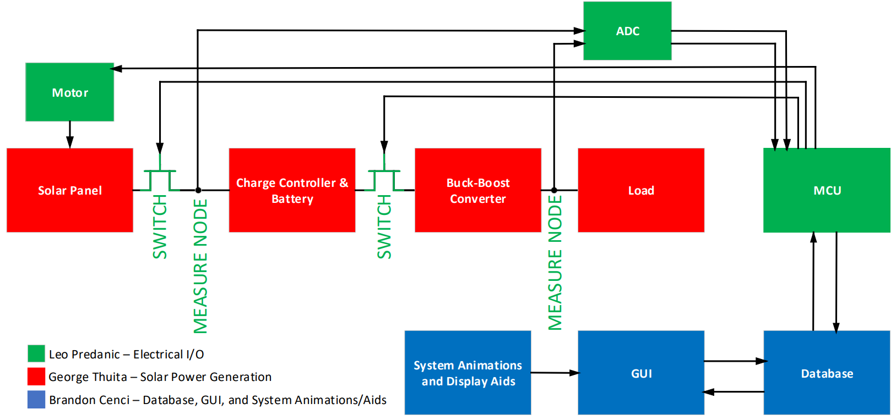
System Flow & Overview

Slide 4
Major Project Changes for 404
One change
Issue during 403 demo with buck-boost converter oscillation
New IC used with max output current of 1A (Original was 200mA)

Slide 5
Parts Ordering Status
System PCB and remaining components ordered
System Power Supply is ordered

Slide 6
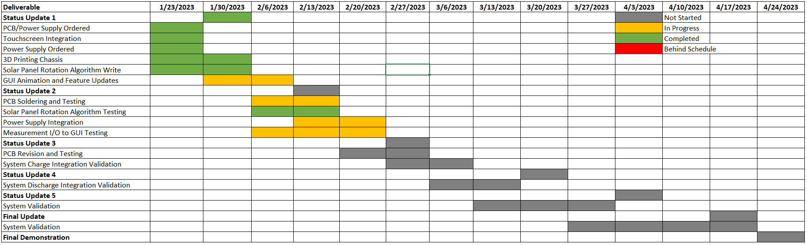
Execution

Slide 7
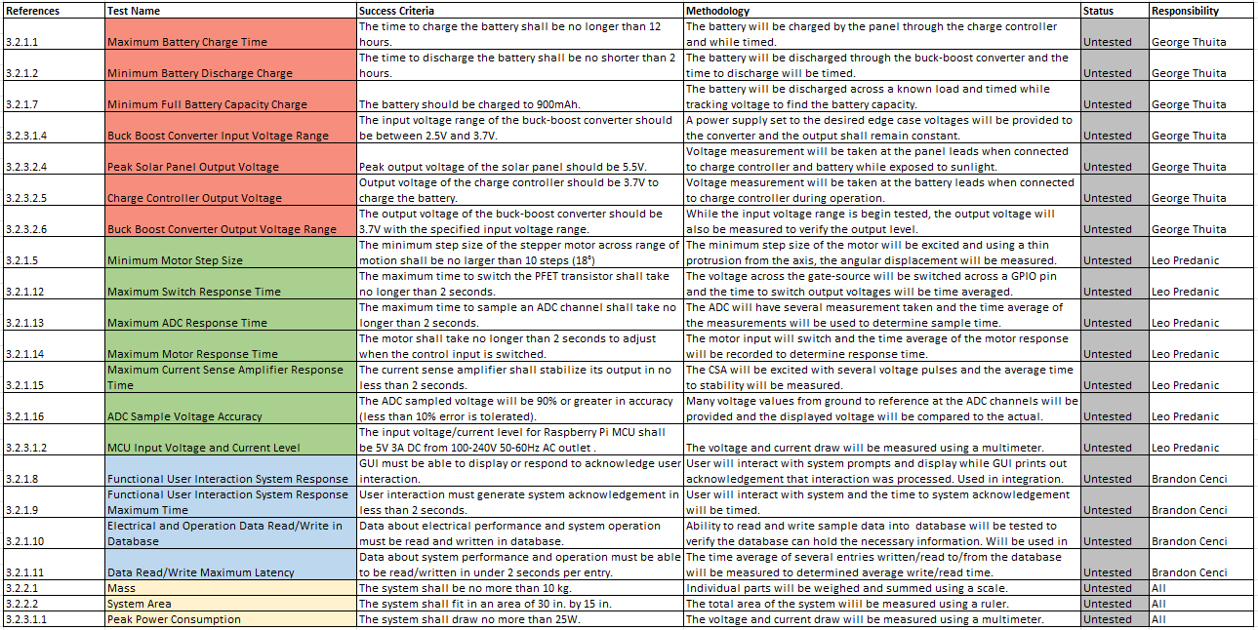
Validation

Slide 8
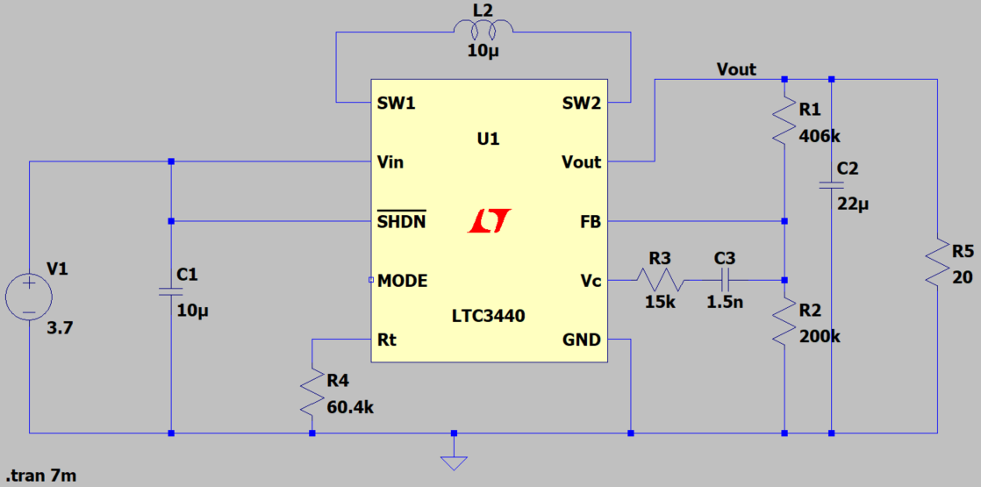
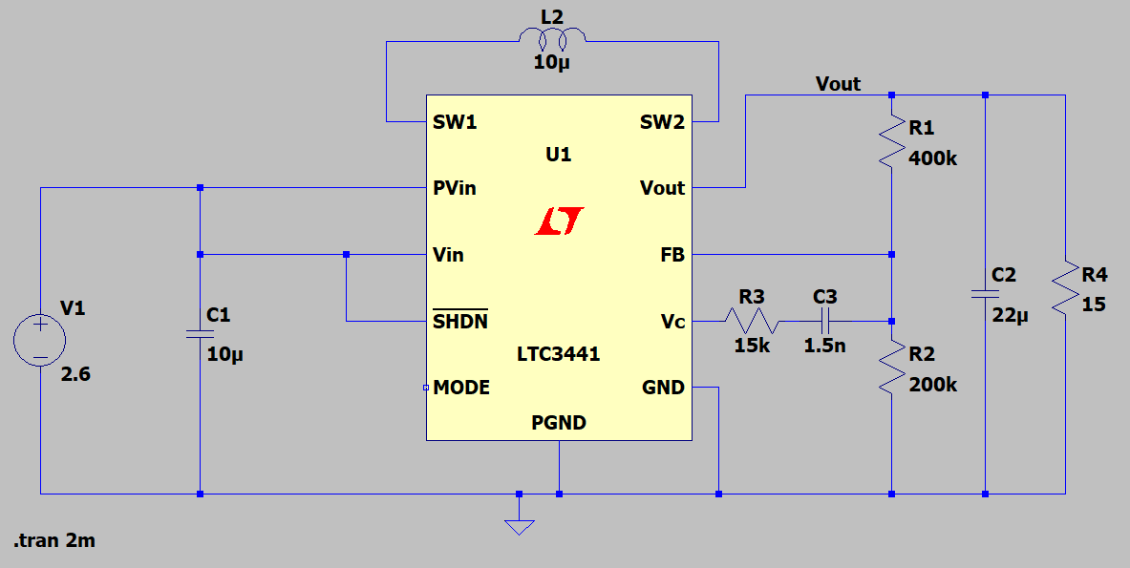
Solar Power Generation George Thuita
Accomplishments since 403 10 hrs | Ongoing progress/problems and plans until next presentation
- Redesigned buck-boost converter - Ordered PCB and remaining parts | - PCB soldering & testing - Assist with writing system integration code - Test measurement data collection for full system - Test system power supply
Input Voltage: 2.5 - 4.2V
Output: 3.7V

Slide 9
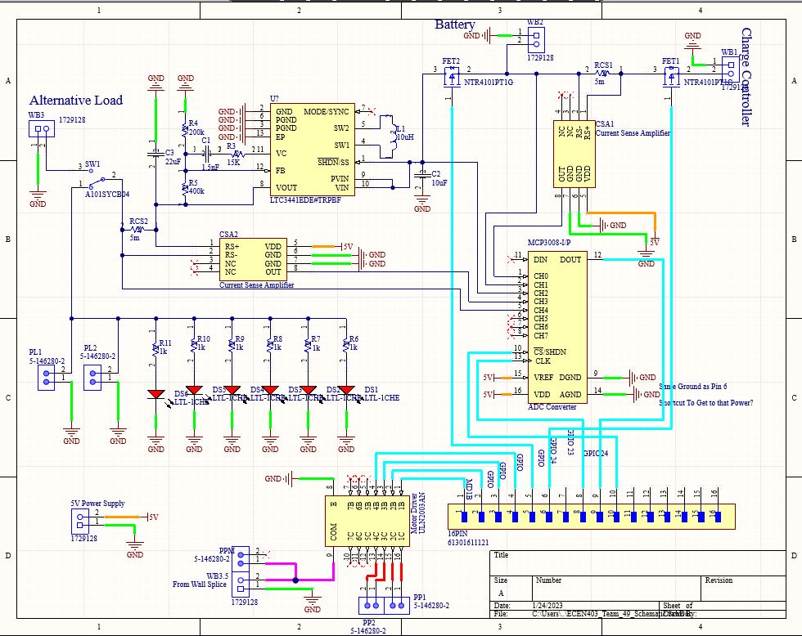
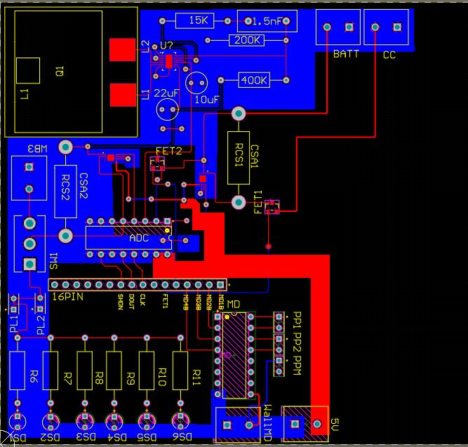
Solar Power Generation (2) George Thuita

Slide 10
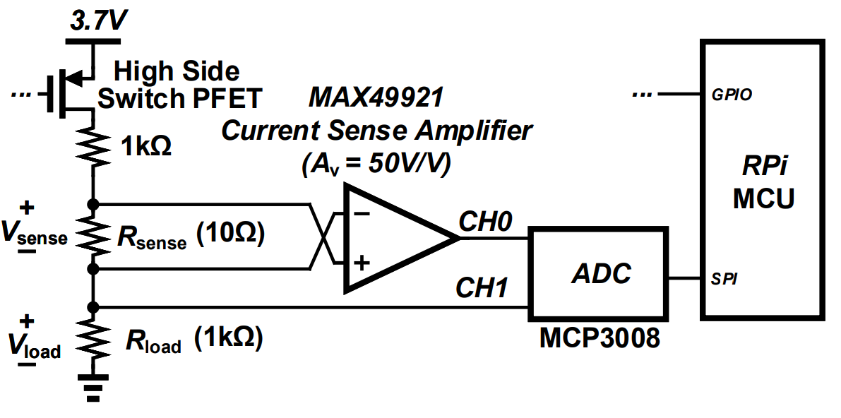
Electrical I/O Leo Predanic
Accomplishments since 403 15 hrs | Ongoing progress/problems and plans until next presentation
- Performed additional verification on motor driver circuit operation - Ordered system power supply and organized power distribution - Wrote/tested solar panel rotation control algorithm | - Assist with PCB soldering & testing - Ability to write measured data to GUI - Acknowledge user input from GUI/touchscreen on RPi - Assist with power supply testing

Slide 11

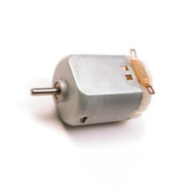


Electrical I/O (2) Leo Predanic
1. 360° User Chosen Starting Angle
2. 180° Rotation From Starting Angle
Initial Angle
3. User Specified Rate
10:00

Slide 12
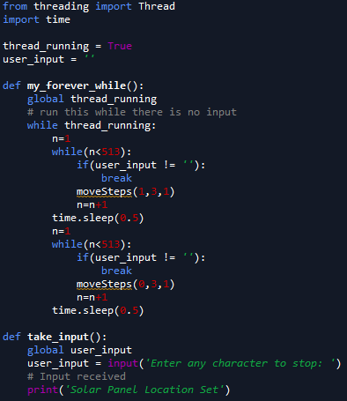
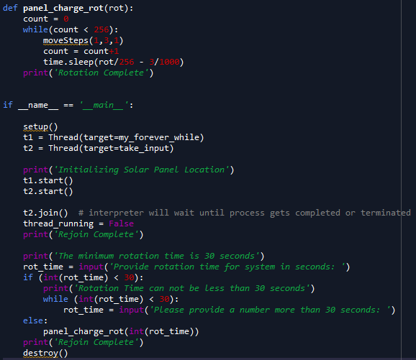
Electrical I/O (3) Leo Predanic

Slide 13
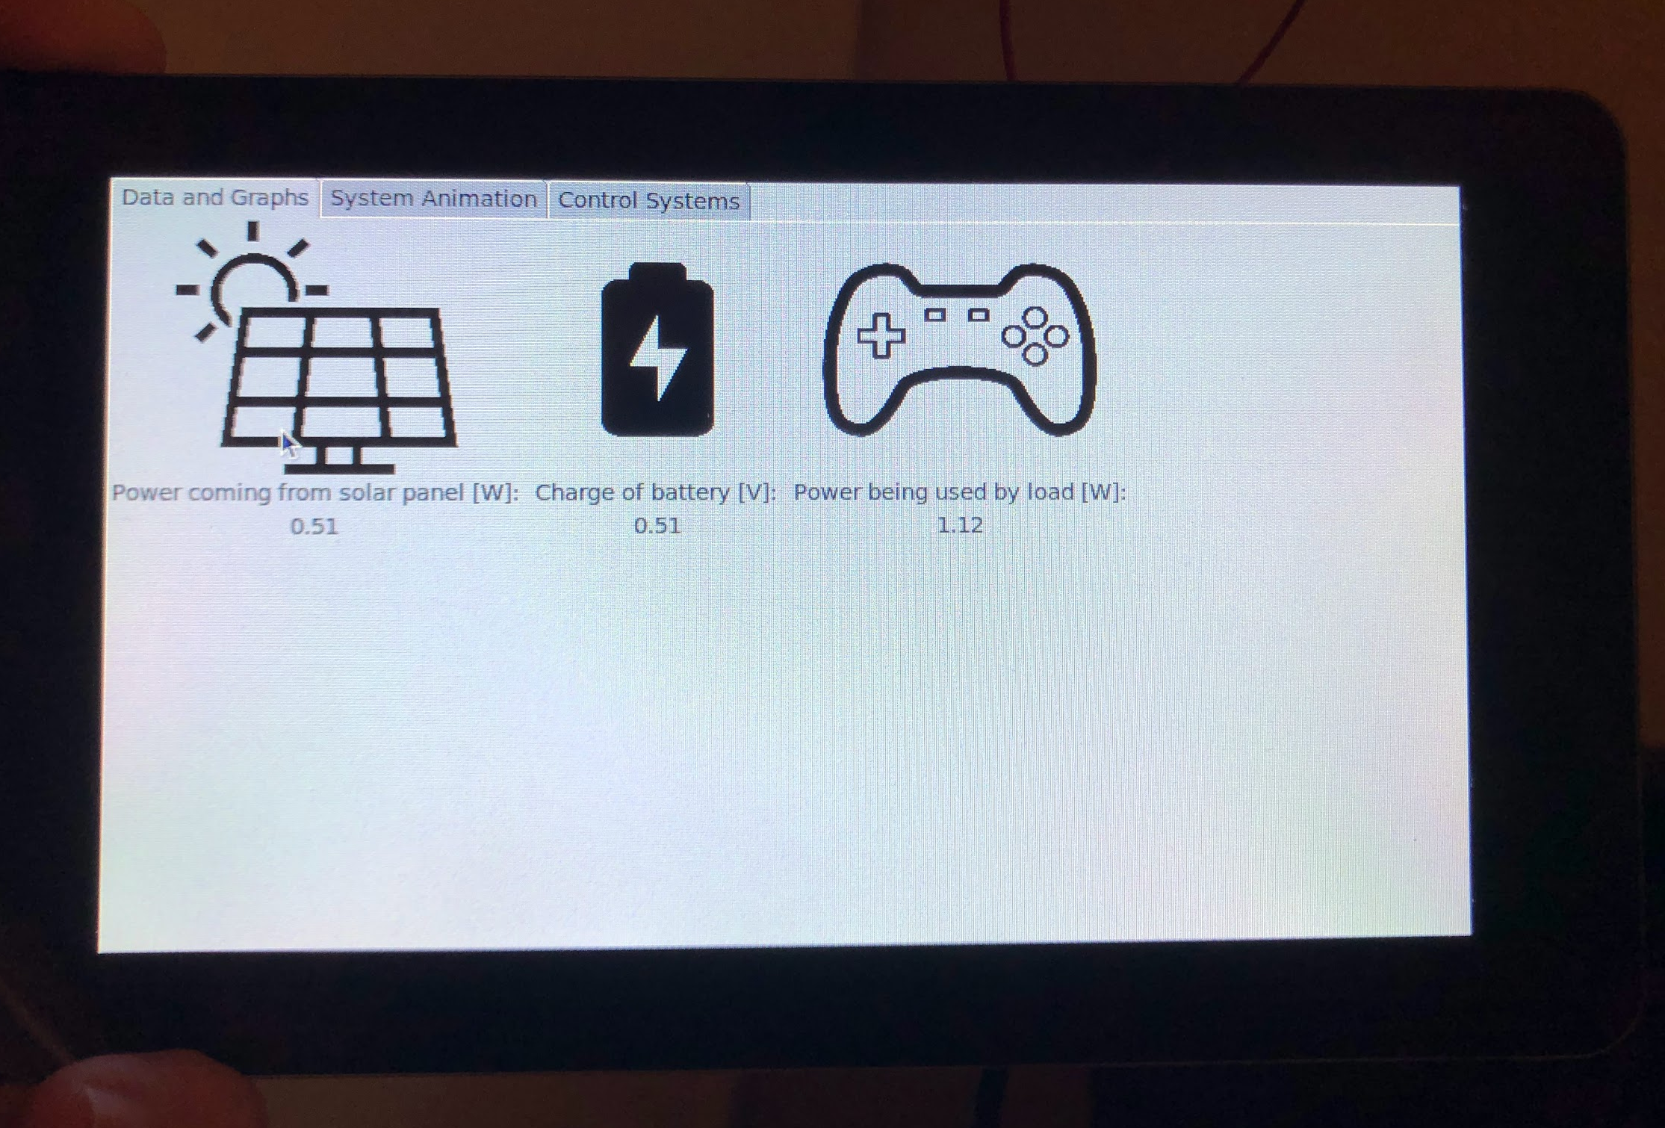
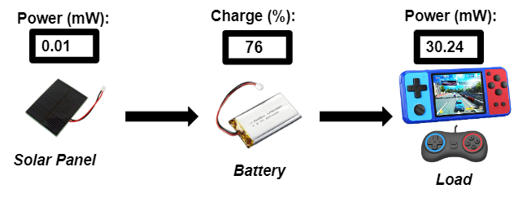
GUI and Database Brandon Cenci
Accomplishments since 403 20 hrs | Ongoing progress/problems and plans until next presentation
- Integrated GUI onto touchscreen - 3D printing the motor and solar panel chassis - Partial completion of new system animations and display feature | - Be able to control read/write through GUI to and from RPi - Test resulting data display - Finish additional GUI features

Slide 14
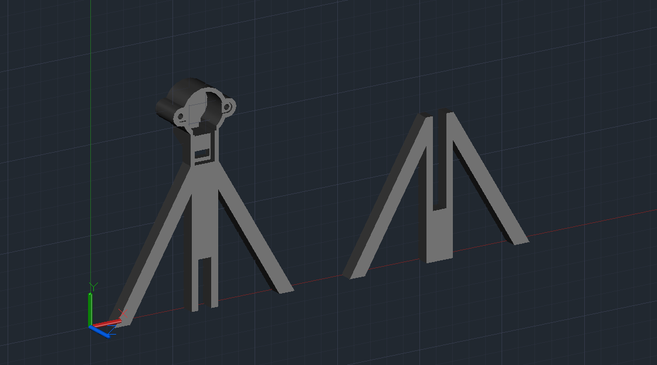
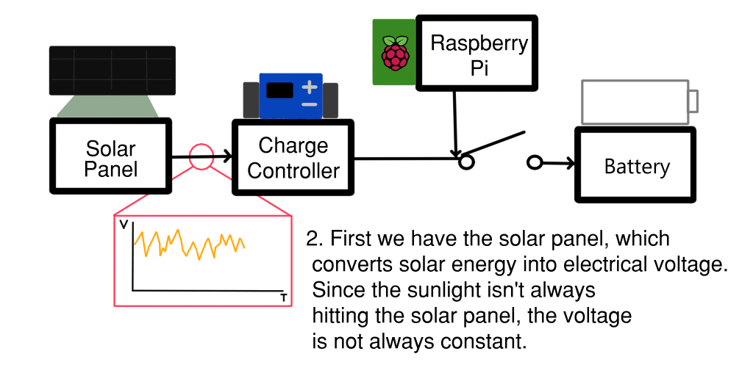
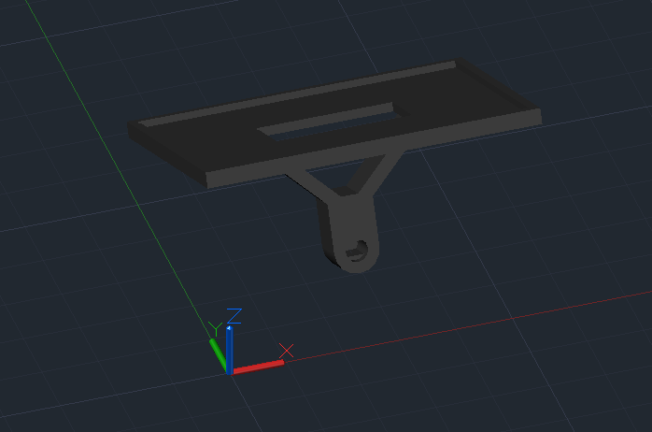
GUI and Database (2) Brandon Cenci
Frame from updated system animation
Top: Model of stand that houses solar panel motor
Bottom: Arm that holds solar panel, mounted to motor

Slide 15
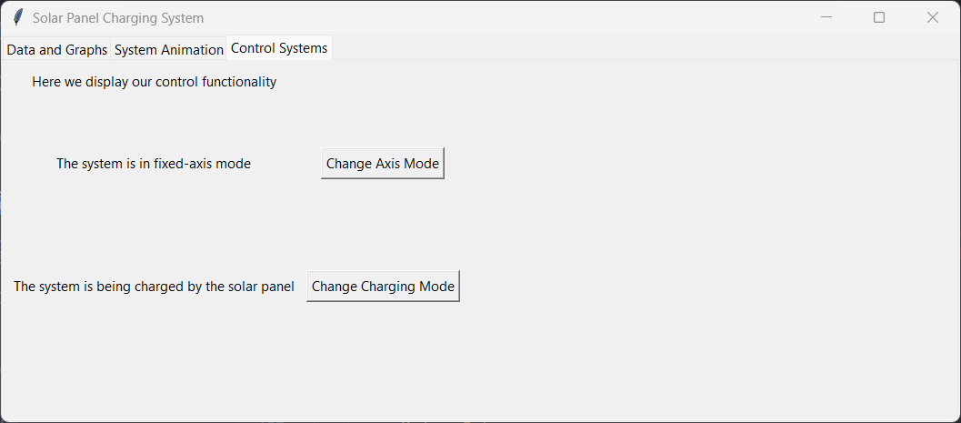
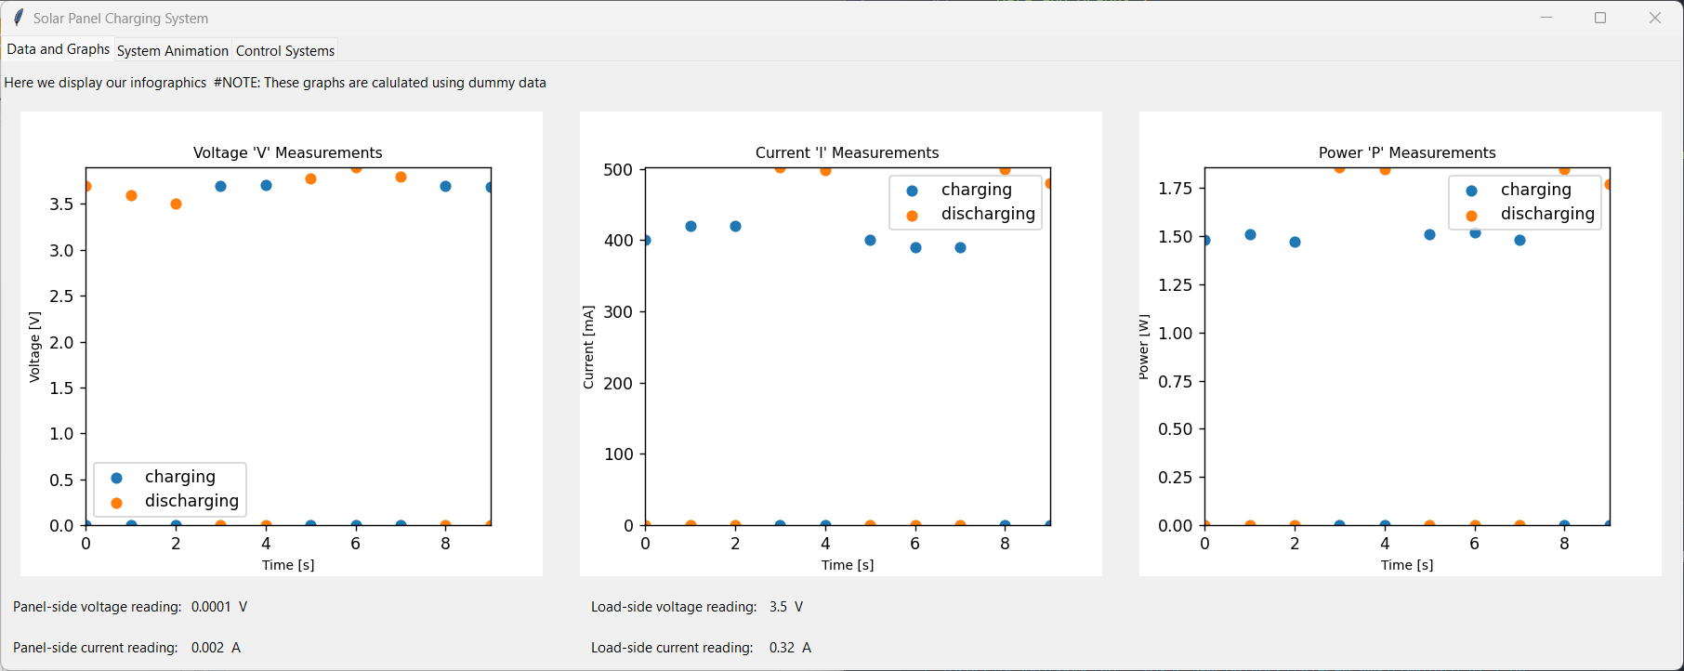
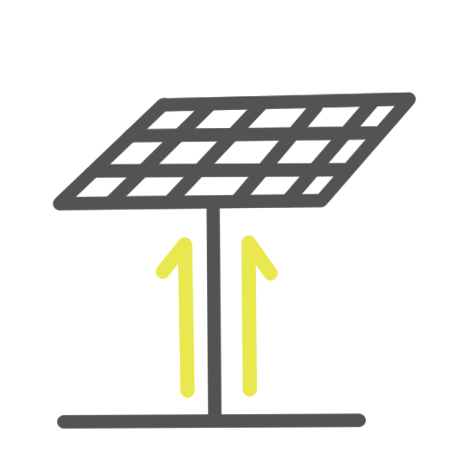
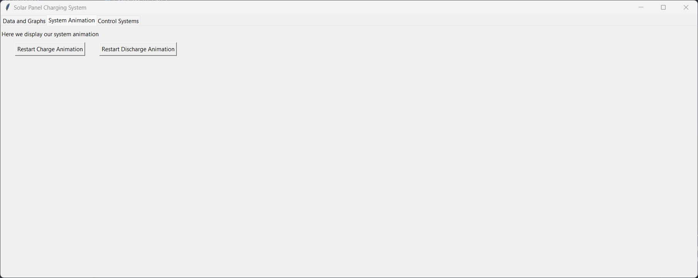
GUI and Database (3) Brandon Cenci

Slide 16
Thank You!
Questions?

Slide 17
1. 360° User Chosen Starting Angle
2. 180° Rotation From Starting Angle
Initial Angle
3. User Specified Rate
10:00

